Slide 1

House price prediction
Submitted by:
ROSHAN KUMAR

Slide 2
Conceptual Background and domain knowledge
Houses are one of the necessary need of each and every person around the globe and therefore housing and real estate market is one of the markets which is one of the major contributors in the world’s economy .Real estate price prediction is crucial for the establishment of real estate policies and can help real estate owners and agents make informative decisions.
With a large amount of unstructured resources and documents, the Real estate industry has become a highly competitive business.
The data science process in such an industry provides an advantage to the developers by processing those data, forecasting future trends and thus assisting them to make favourable knowledge-driven decisions.
Data science comes as a very important tool to solve problems in the domain to help the companies increase their overall revenue, profits, improving their marketing strategies and focusing on changing trends in house sales and purchases.
The aim of this study is to employ actual transaction data and machine learning models to predict prices of houses.
The actual transaction data contain attributes and transaction prices of real estate that respectively serve as independent variables and dependent variables for machine learning models

Slide 3
Problem Definition
A US-based housing company named Surprise Housing has decided to enter the Australian market. The company uses data analytics to purchase houses at a price below their actual values and flip them at a higher price.
The company is looking at prospective properties to buy houses to enter the market. We are required to build a model using Machine Learning in order to predict the actual value of the prospective properties and decide whether to invest in them or not.
The aim of project is to find out which variables are important to predict the price of houses and how do these variables describe the price of the house .
The goal is to model the price of houses with the available independent variables and understand how exactly the prices vary with the variables and developing a model which not only predicts the sale price of properties for a customer according to his\her interests, but also recognizes the most preferred location of real estate and other utilities and features in any given area.
Further, the model will be a good way for the management to understand the pricing dynamics of a new market and yield high returns.

Slide 4
Dataset Description
Two datasets are being provided to (test.csv, train.csv). We will train on train.csv dataset and predict on test.csv file.
The train dataset has 81 columns and a total of 1168 records (rows).Where there are 80 inputs/features and 1 target column(label) Sale price is our target variable.
The test dataset has 80 columns and a total of 292 records (rows) for which we need to make the predictions.
Data contains Null values in 18 features. Which needs to be treated them using the domain knowledge and own understanding.
Data contains numerical as well as categorical variable.
There are about 9% of outliers in the data.
Most of the columns are categorical in nature.

Slide 5
Data pre-processing
Before we feed the data to the model we should make sure our data is clean and well structured.
Few pre-processing steps carried out on the dataset are:
Treating Nan values: There were 18 features with Nan values out of which we have dropped features which had more than 90% Nan values. For rest of the features in case of integer or float a simple imputer is used to fill the Nan values with different strategies
Data-Type Conversions: The float columns were converted into integer and a few columns which were numeric but had very less unique values were converted to categorical data type in order to treat them wisely.
Label encoding: The machine learning model can only understand numbers hence we need to convert/encode all the categorical columns into numbers. Label encoder has been used for the same.
Treatment of outliers: flooring and capping method is used to reduce the outliers.
Dropping unnecessary features: features with 0 correlation with the target variable are dropped some redundant features are also dropped in order to increase model efficiency
Skewness reduction: as the features had uneven distribution power transformation is used to reduce the skewness. The method used is yeo-Johnson.

Slide 6
Data Visualization
Data analysis and data visualization are not entirely exclusive work sets – they co-exist and feed off of each other.
Thus data visualization aids in gaining useful insights from large data and makes it easy to understand.
In the journey from analysis to data-driven outcomes, data visualization plays a very important role of presenting data in a powerful and credible way.
There are many different scenarios where large amounts of data must be displayed to an audience – a business may need to present sales figures to their directors.
A research team may need to display their findings to investors, or a teacher may need to display statistics to their students for example.
Data visualization allows this information to be displayed in an easy to read format that is both attractive and functional.

Slide 7
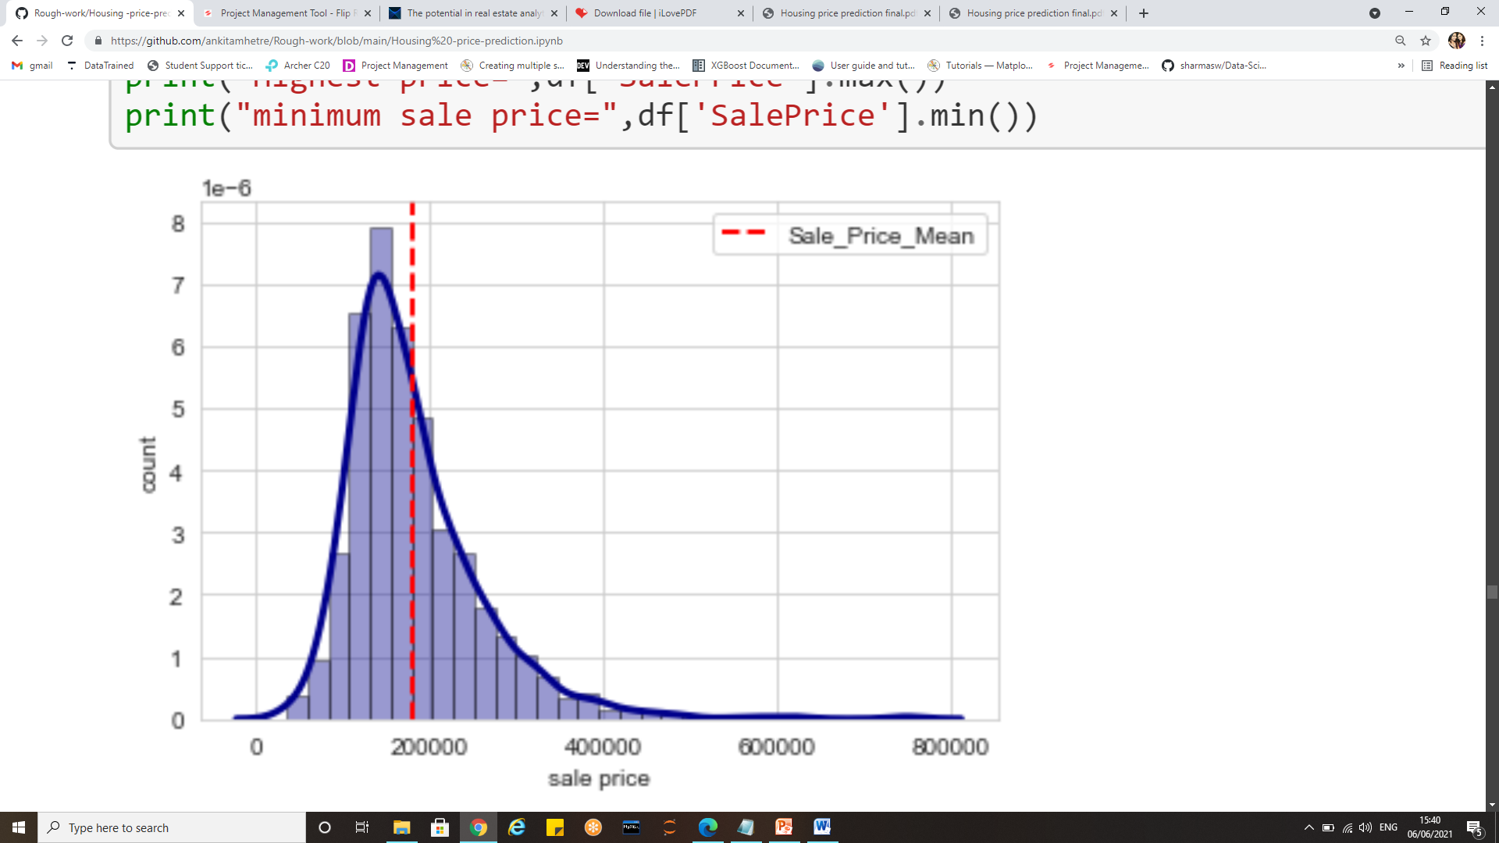
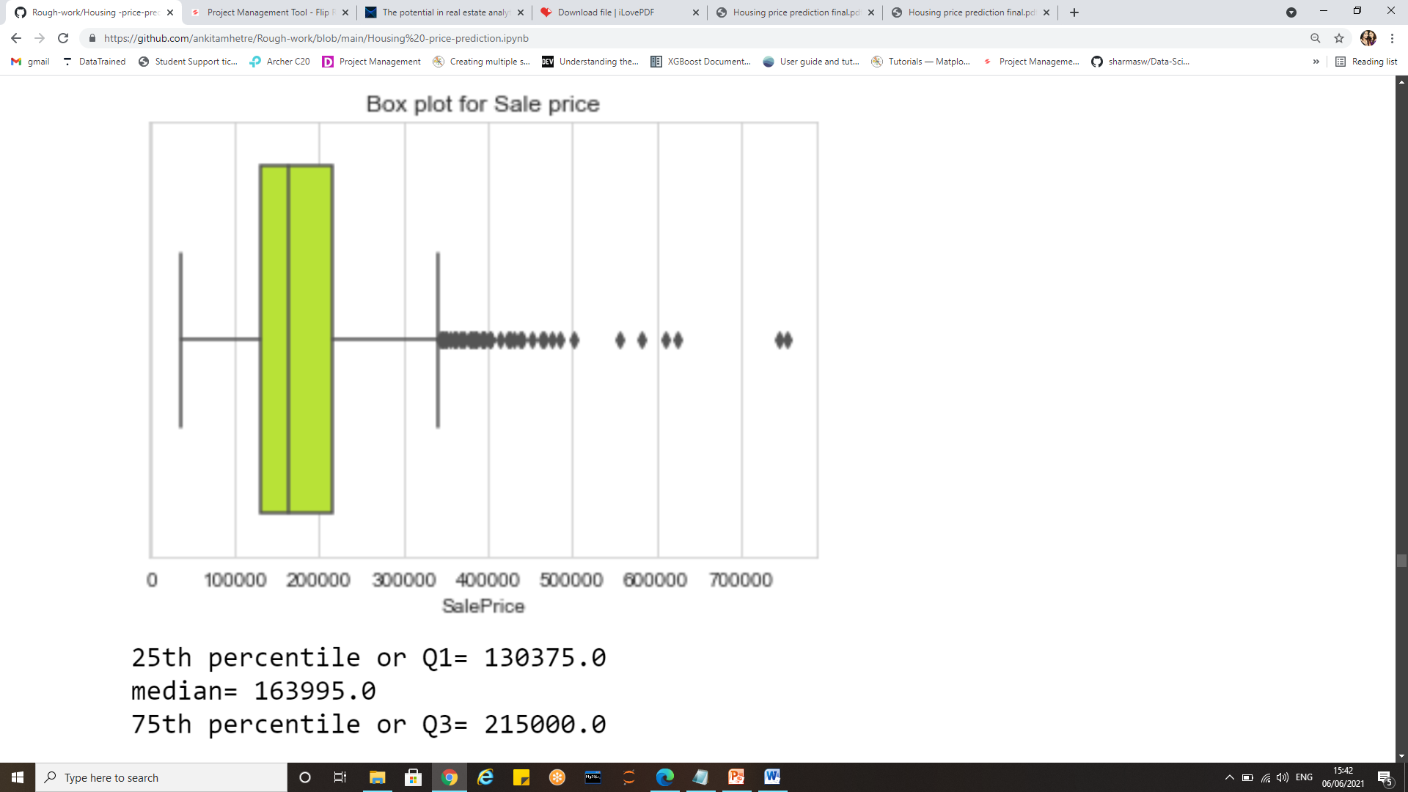
Target variable: “Sale price”

Slide 8
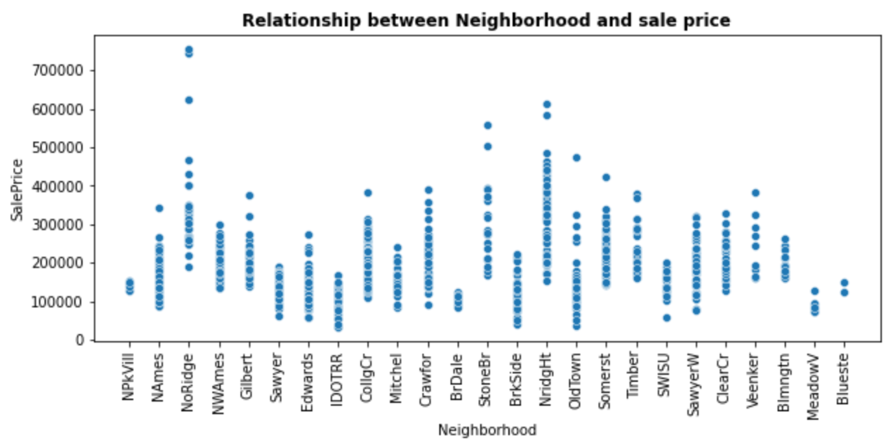
Relationship between locality and sale price

Slide 9
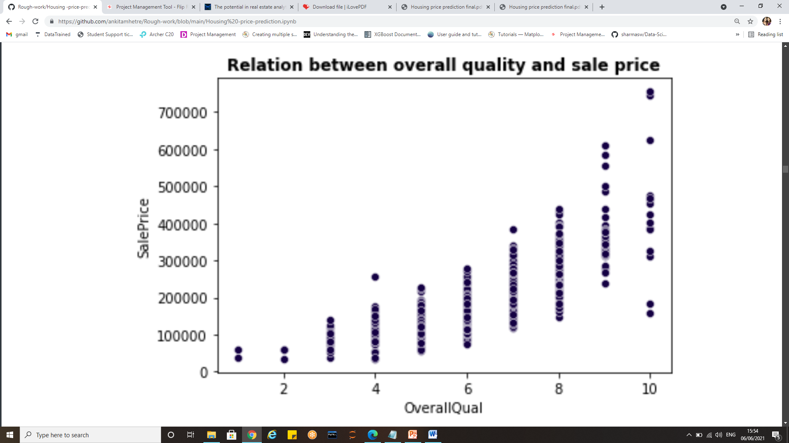
Relationship between overall quality and sale price

Slide 10
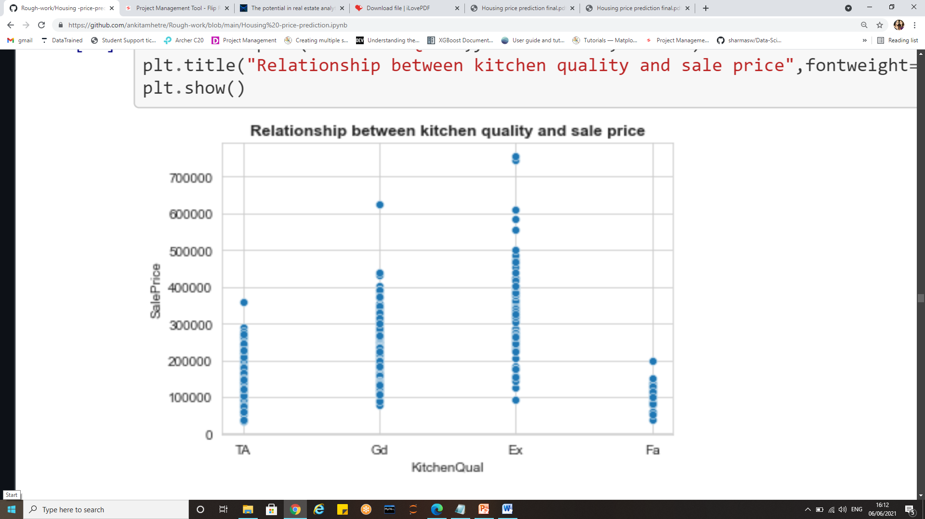
Relation between Kitchen quality and sale price

Slide 11
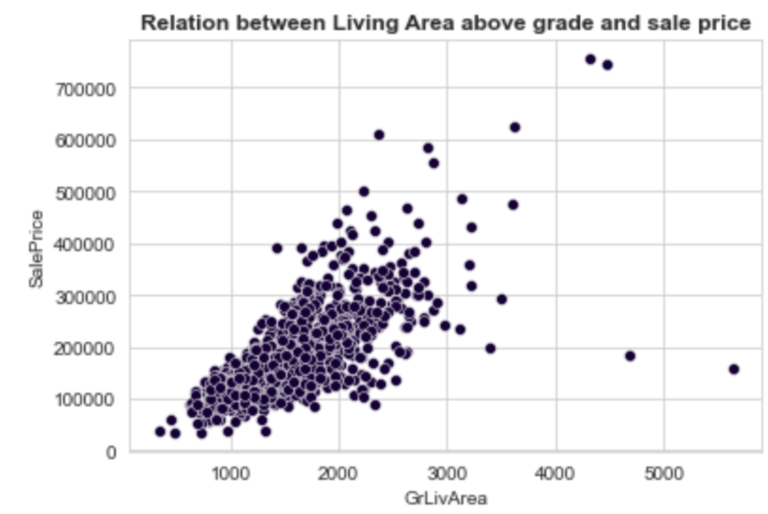
Relationship between Ground living area and sale price

Slide 12
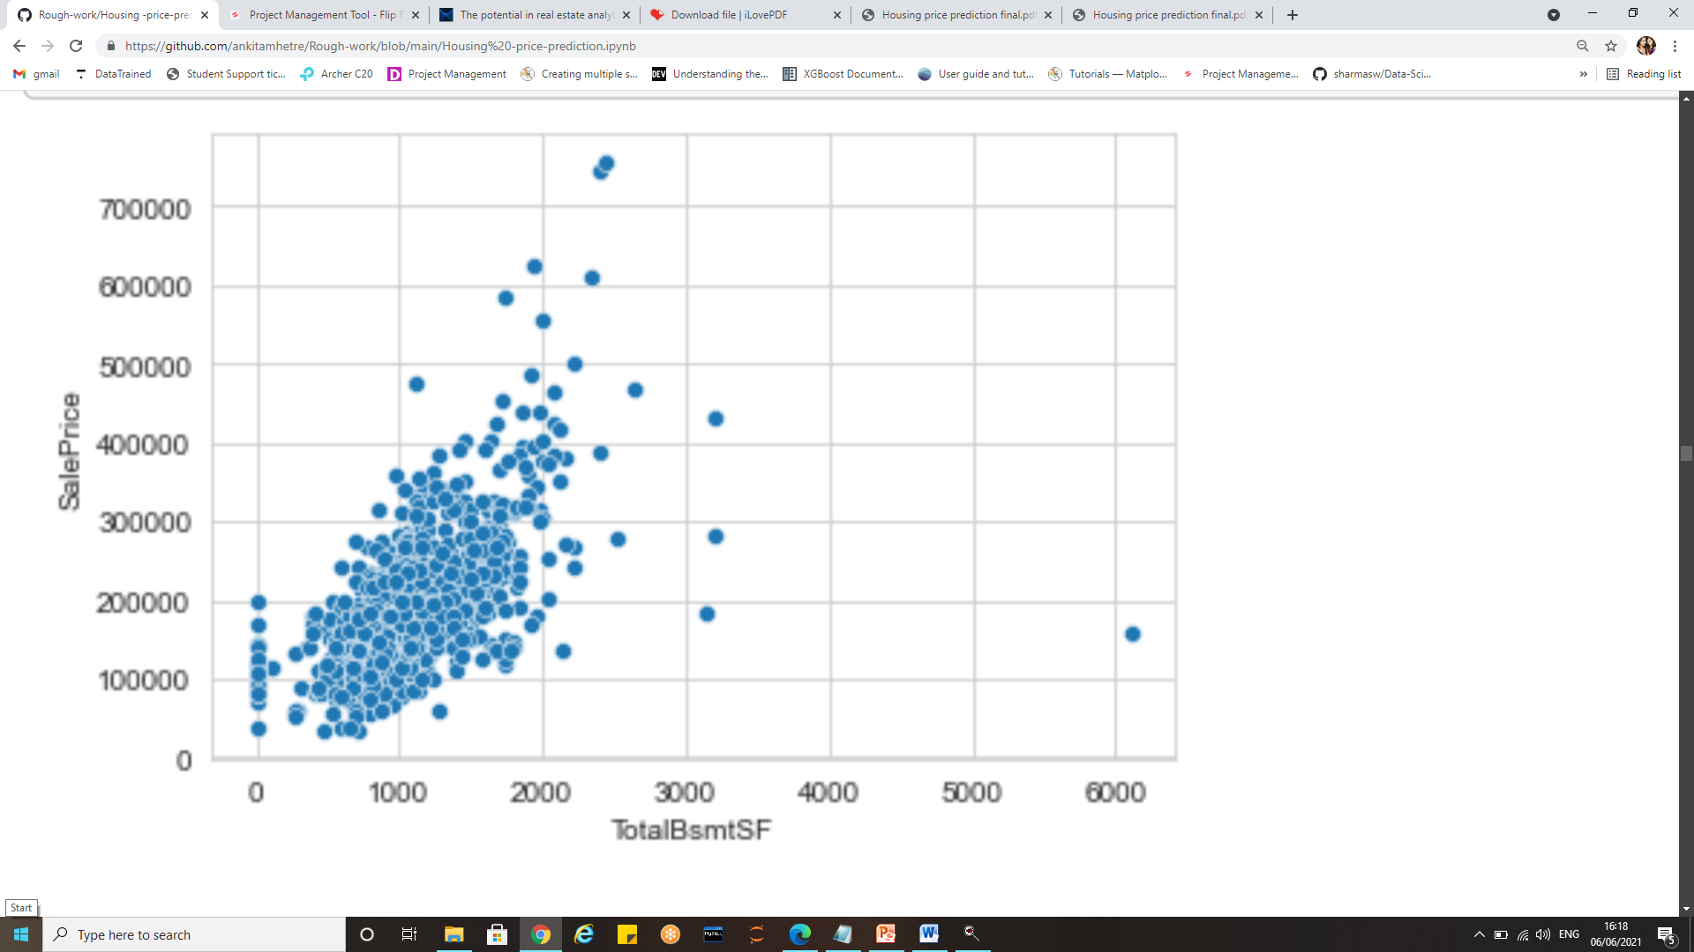
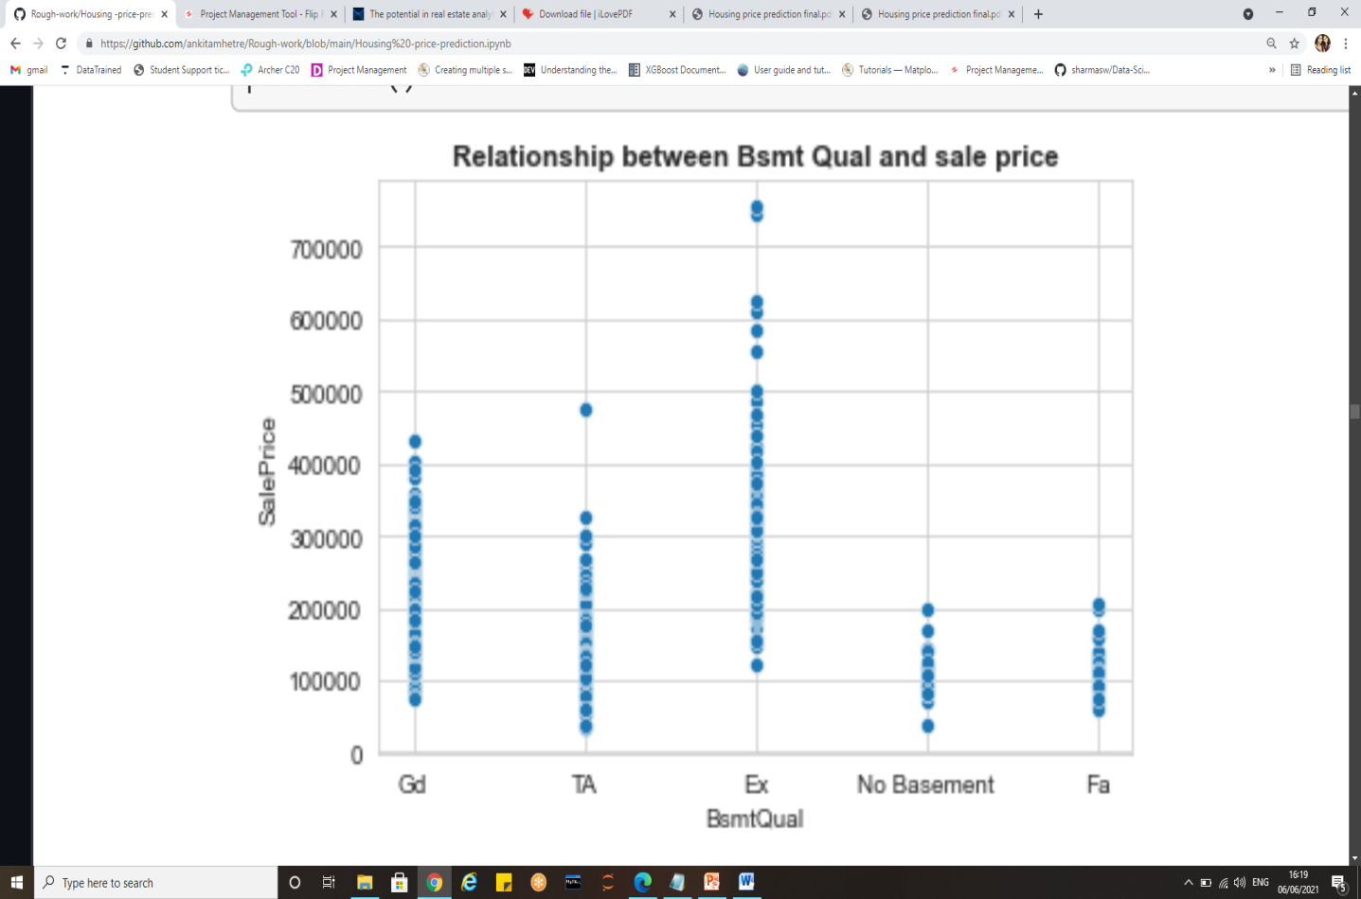
Basement features and sale price

Slide 13
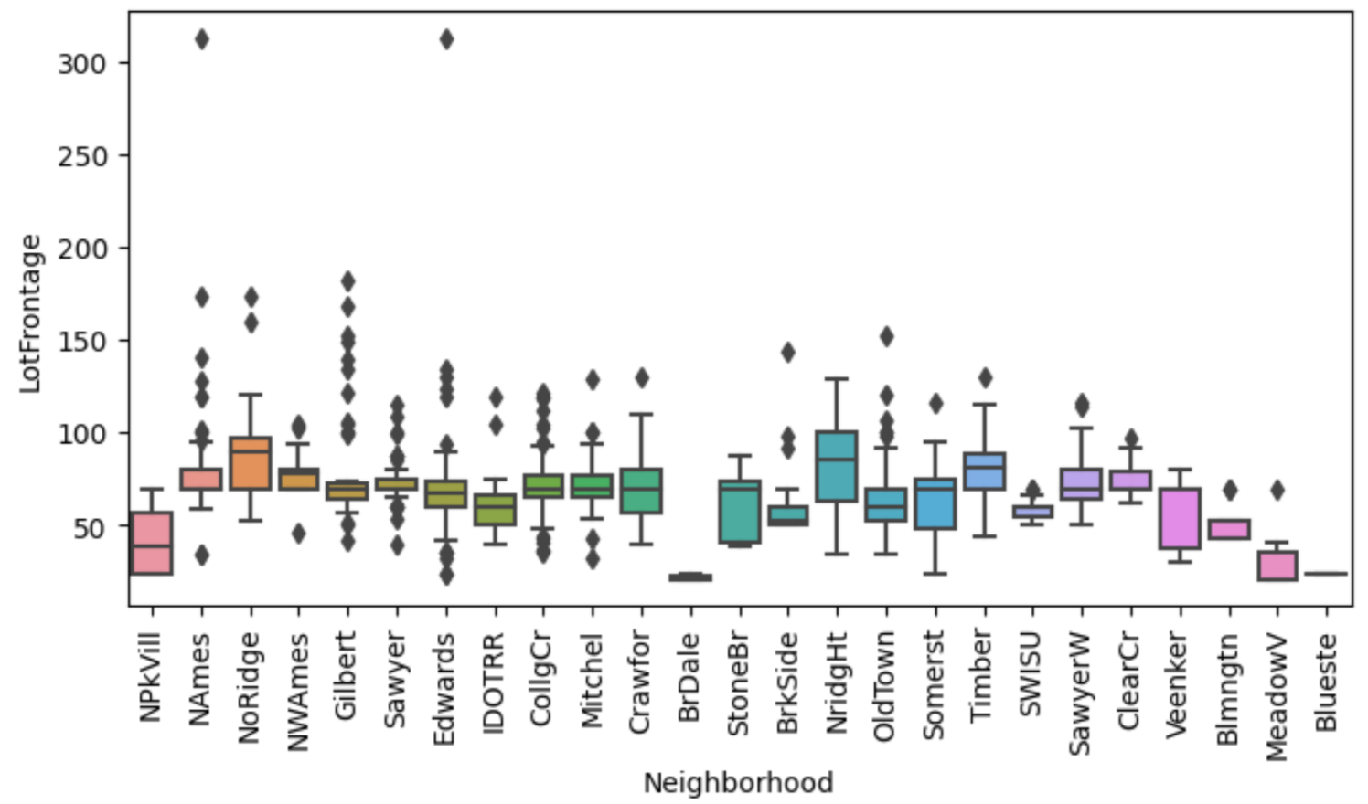
Neighbourhood and Lot Frontage relation

Slide 14
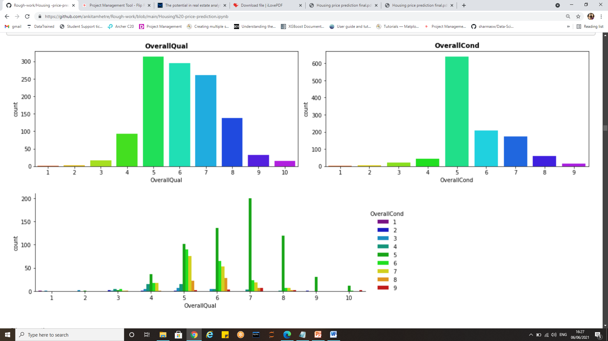
Overall quality and condition

Slide 15
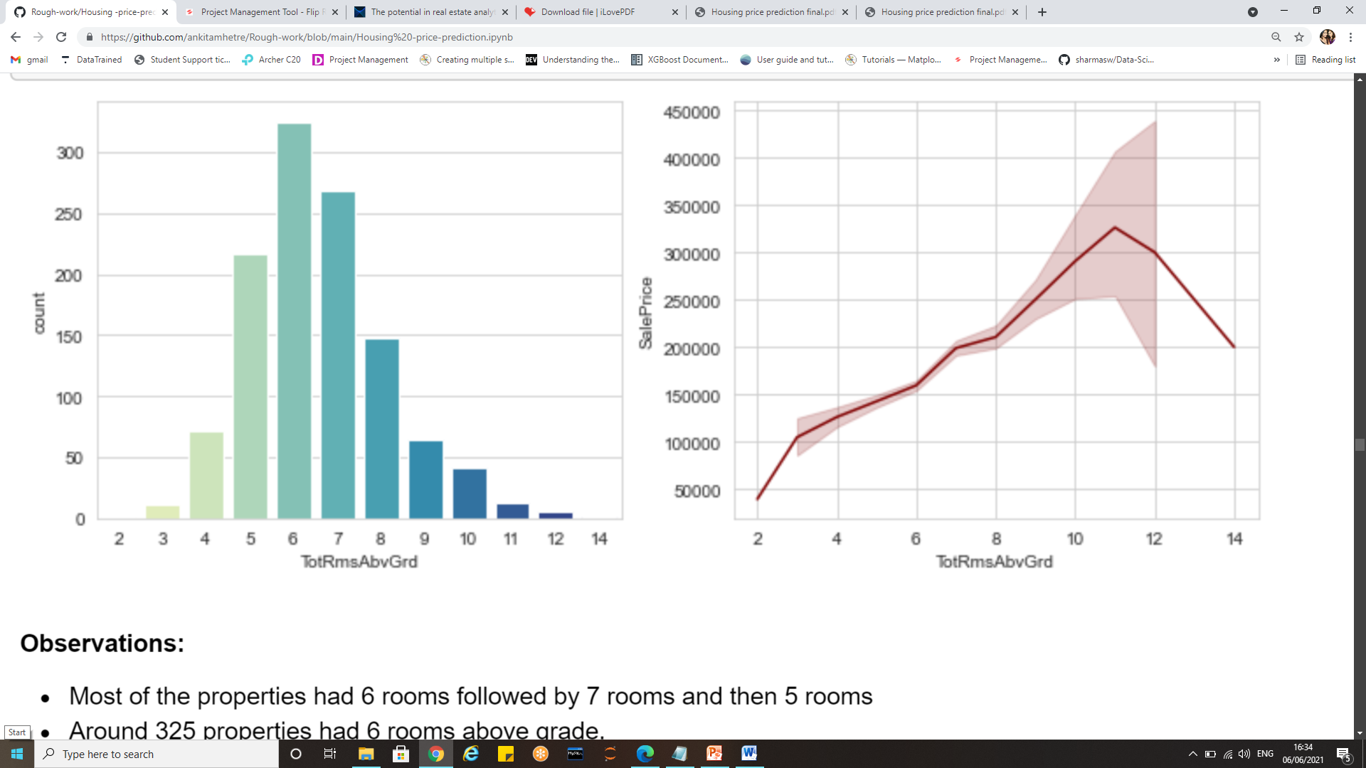
Total rooms above grade

Slide 16
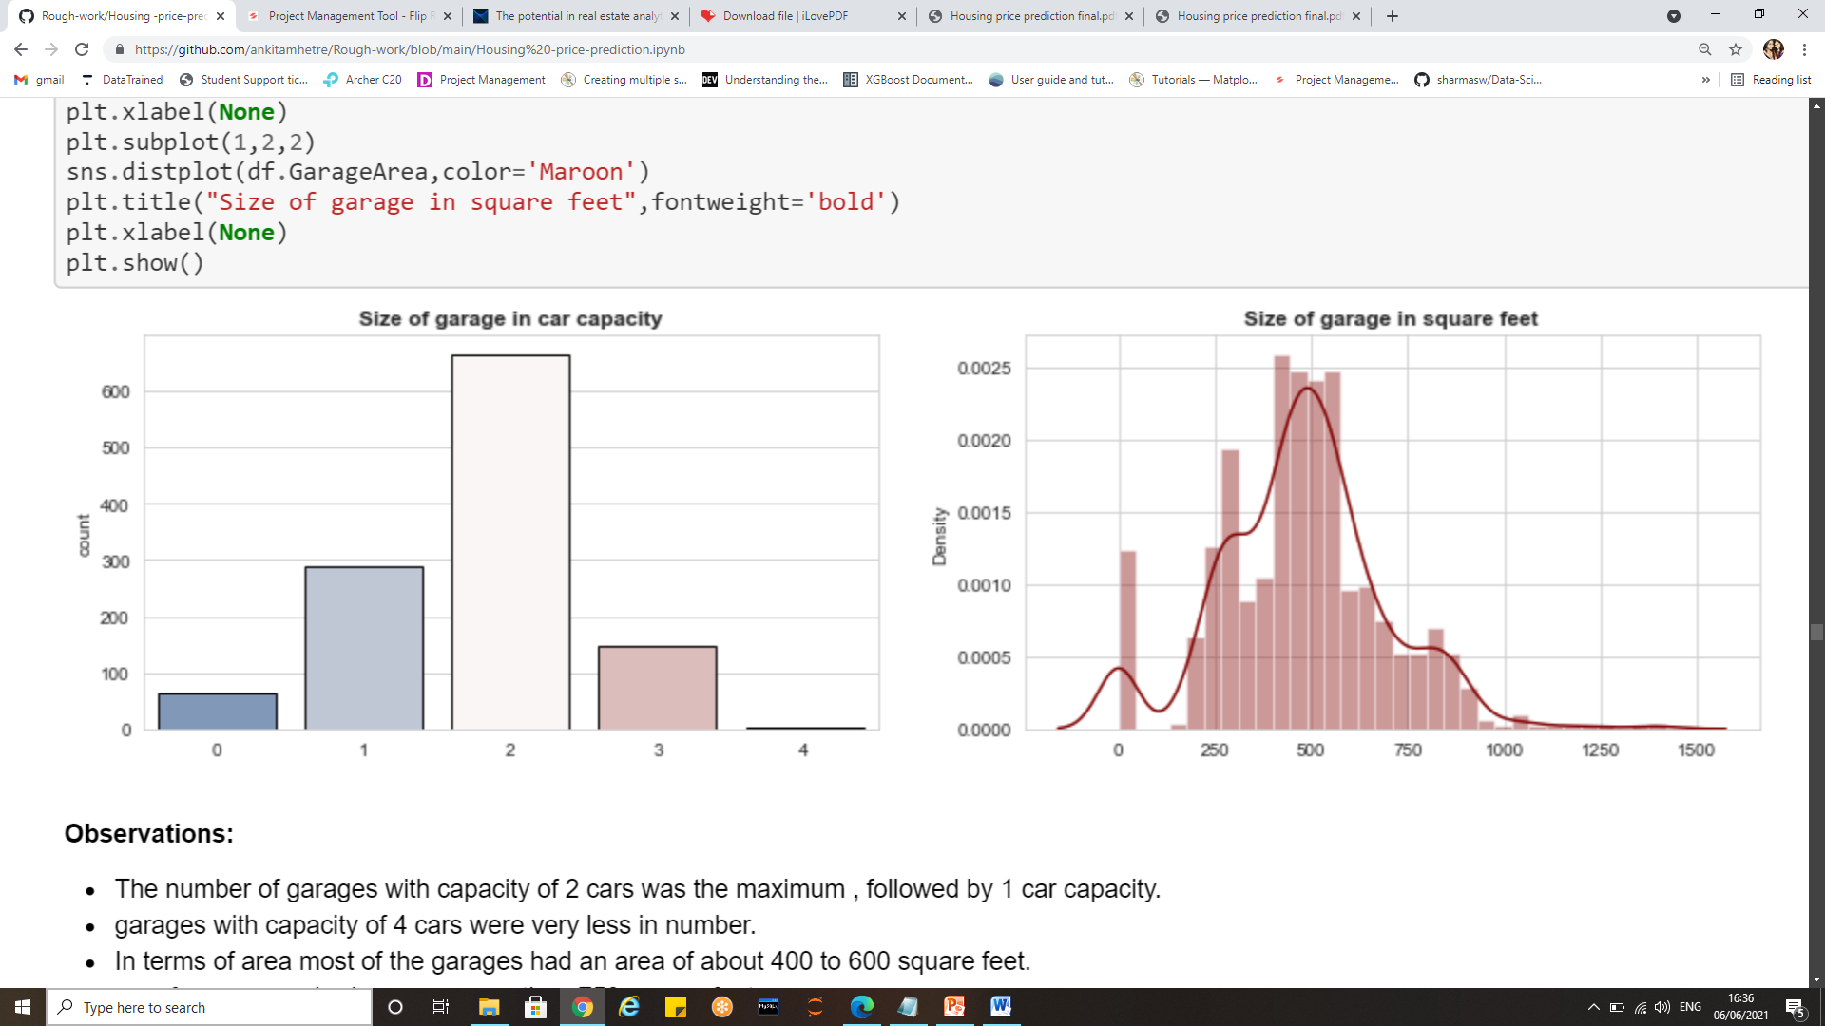
Garage capacity

Slide 17
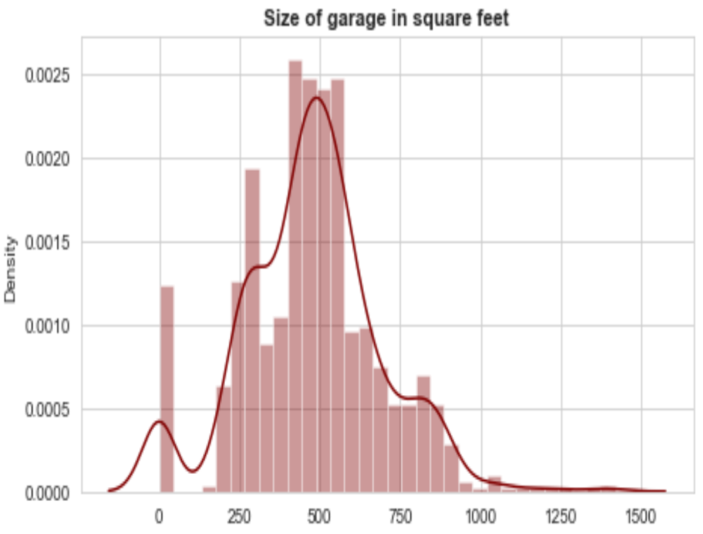
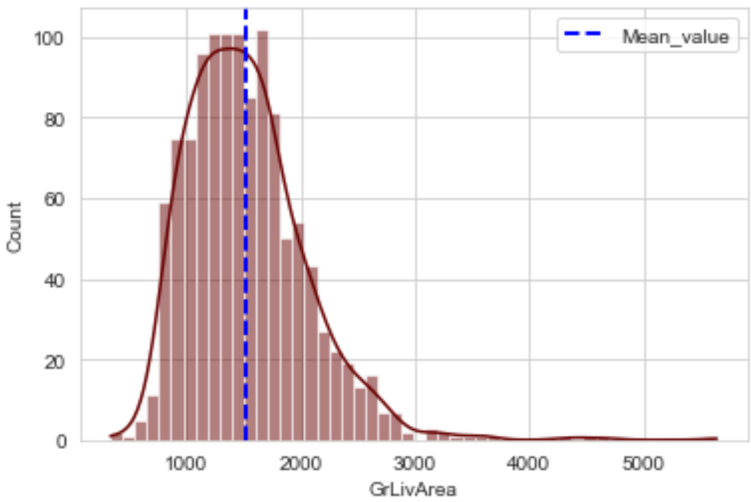
Distribution plots

Slide 18
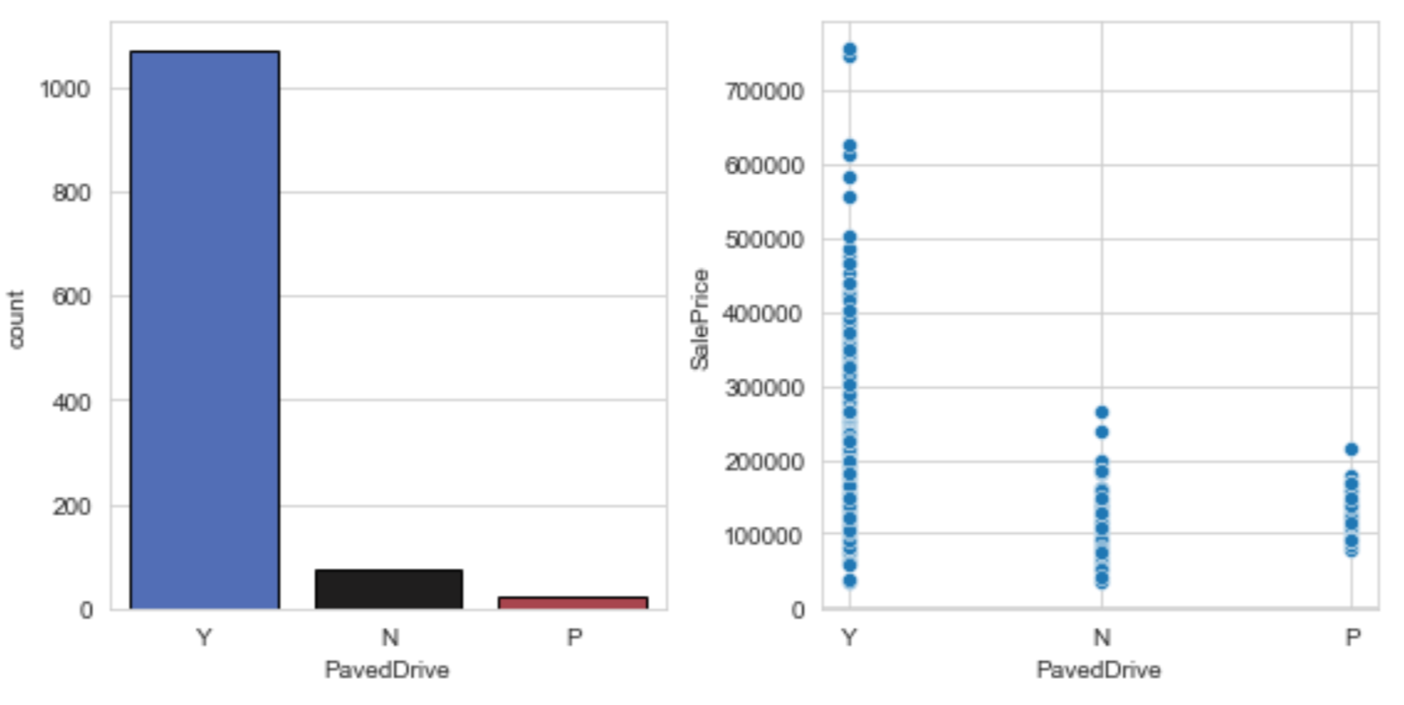
Paved drive and sale price

Slide 19
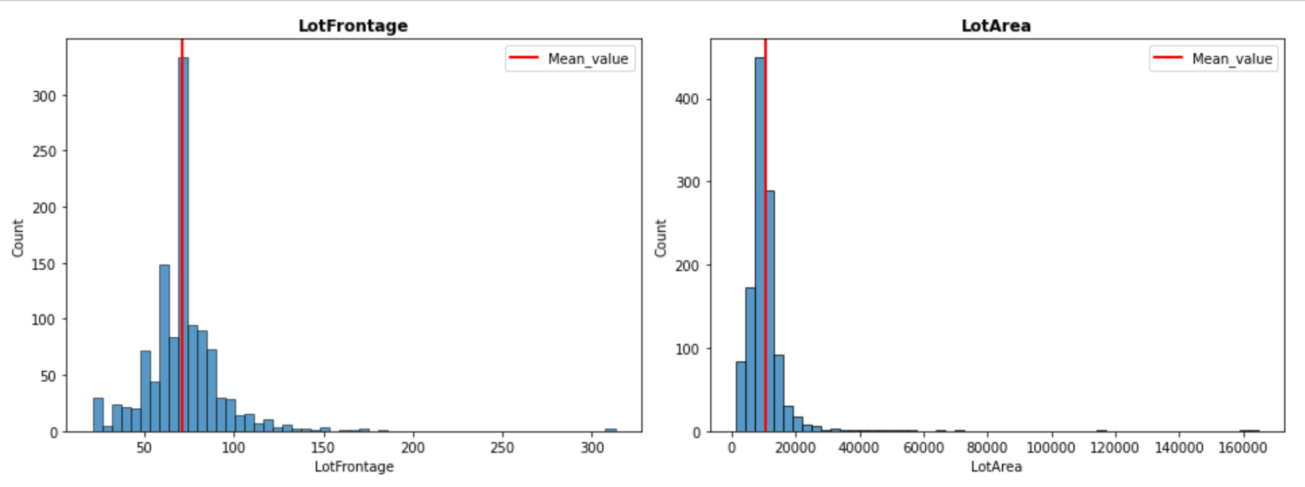
Lot Frontage and Lot Area distribution

Slide 20
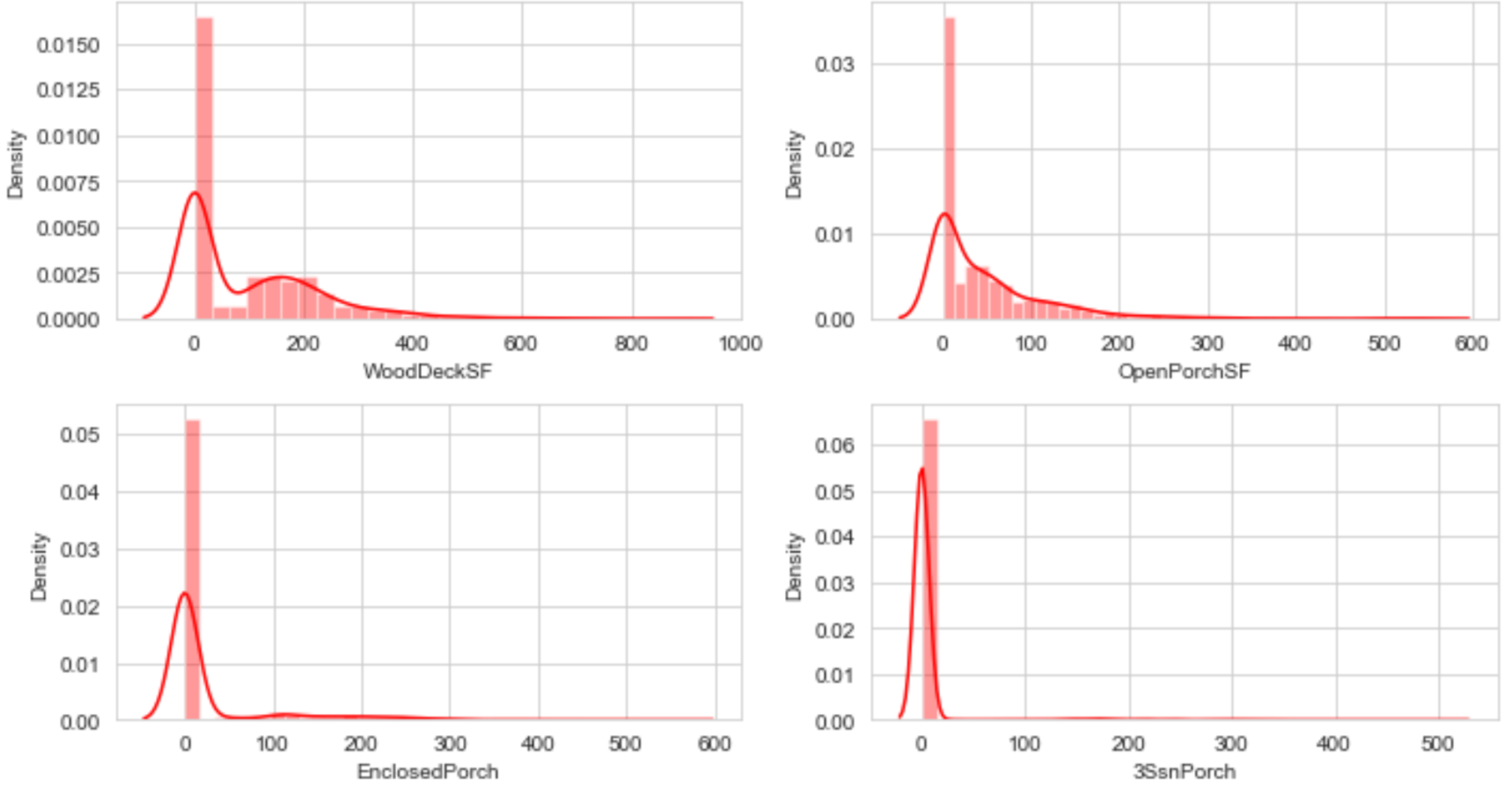
Distribution plot for porch areas

Slide 21
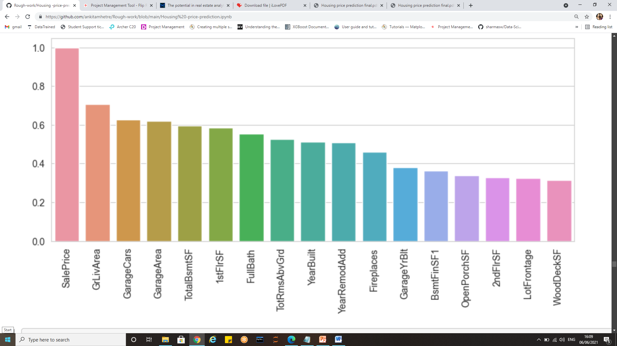
Correlation co-efficient between inputs and output

Slide 22
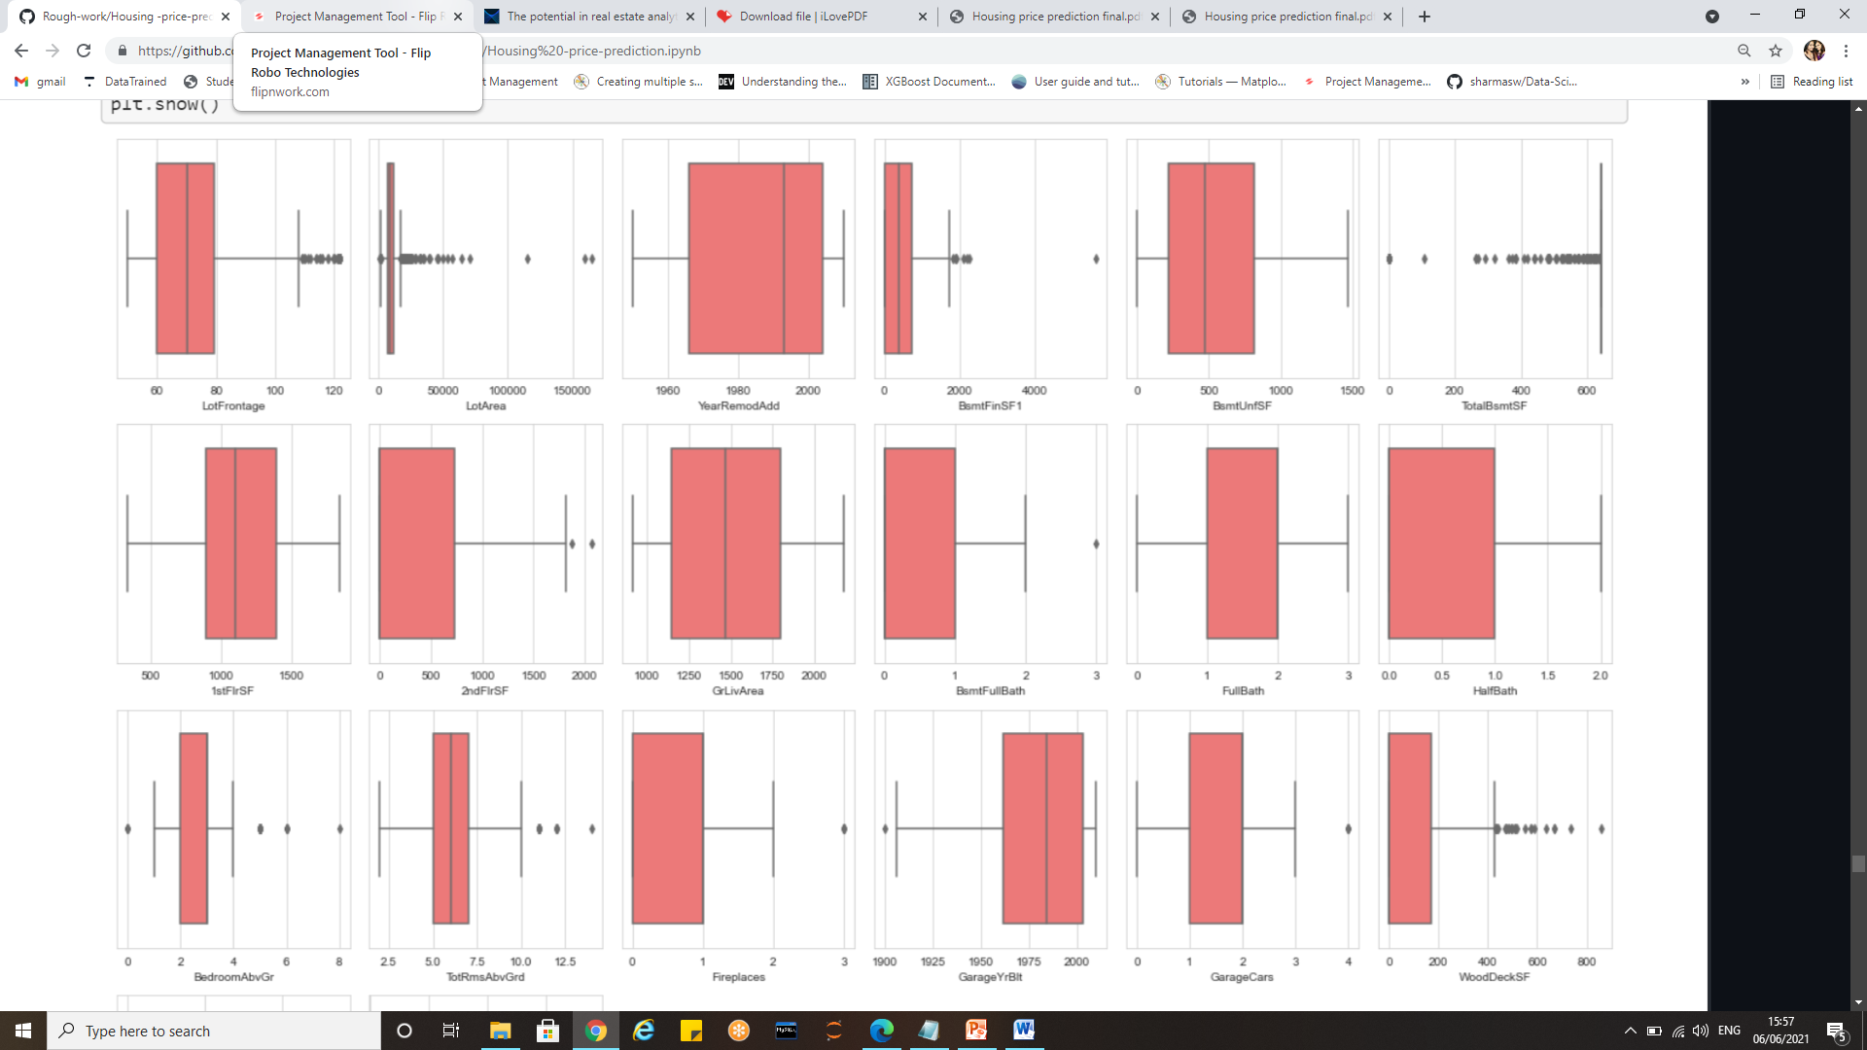
Box plots to visualise outliers

Slide 23
Inferences from visualizations
Columns with highest positive correlation with the target are:
GrLivArea(0.71)
GarageCars (0.63)
GarageArea (0.62)
TotalBsmtSF(0.60)
1stFlrSF (0.59)
FullBath(0.55)
TotRmsAbvGrd(0.53)
YrBuilt(0.51)
YrRemodAdd(0.51)
Neighbourhood i.e. Physical locations within Ames city limits had a great impact on the sale prices. It had a co-relation co-efficient of 0.73 with the target. Northridge and Northridge Heights had the sale prices starting from a higher rate as well as ending with maximum sale prices as compared to other locations.
Northridge and North Ridge heights had higher lot frontage area. North park villa, Bluestem, Briar Dale and Meadow areas had less sale prices.
The properties with very excellent quality of material and finish had sale prices starting from 200000 and went as high as 750000.Properties with poor, very poor and fair kind of qualities had the minimum sale prices that ranged between 1, 00,000 to 2, 00,000.The better the overall quality of properties, higher the sale prices.

Slide 24
Inferences from visualizations
The above grade living area ranged from 334 square feet to maximum 5642 sq.ft. Most of the properties had areas as 864 sq.ft ,1040 sq.ft and 890 sq.ft. The mean value of living area above grade is 1525.
Properties with paved drive had higher sale prices. Also most of them had paved drive way.
Features that greatly contribute to house price predictions were locality (neighbourhood) ,above grade living area ,parking capacity of the properties, Basement area and area above grade, facilities like electricity, water, gas septic tanks, fire place, number of full and half baths, the year of construction, Overall quality of the house including exterior and material quality.
Few features like MS Zone, Miscellaneous features, land slope, month in which property was sold, and etc. did not make any significant impact on the prediction of sale prices.

Slide 25
Statistical and descriptive analysis
Statistics and probability can be used to figure out trends in data set.
Df.corr() is used to determine the correlation between features and target variable.
The zscores are calculated in order to determine the outliers present in the dataset.
Zscores>3 are treated as outliers
Df.desrcibe() is used to view the mean, median and various percentiles of the features.
Df.quantiles()method is used to find out particular percentiles.
To sum up all, Exploratory Data Analysis is a philosophical and an artistic approach to gauge every nuance from the data at early encounter.

Slide 26
EDA concluding remarks
Upon performing the statistical analysis it could be seen that there are outliers as the difference between the 25th percentile and minimum values as well as the 75th percentile and maximum value is huge.
The standard deviation are high
Few Features posses skewness.
The amount of data where z-scores are greater than 3 accounts to 9% which would result in data loss if the records are dropped
Few outliers in the data are treated based on Inter quartile range.
There are 18 features with Nan values which we have imputed using simple imputer .
Out of 80 features many of them are irrelevant with respect to the target i.e. sale price.
We have decided on the most relevant features by finding correlation between the input variable and target.

Slide 27
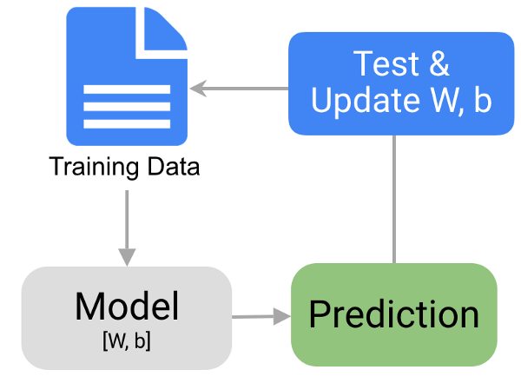
Model Building
The process involves training a model over a set of data, providing it an algorithm that it can use to reason over and learn from those data.
As the target variable is continuous it is a regression problem.
The steps involved in model building are as follows:
Assign input/features and output/target to different variables.
Split the data into train and test dataset.
Train the model on the data provided
Test the model using various evaluation metrics
Use the trained model to make predictions
Save the trained model for future use.

Slide 28
Algorithms and evaluation metrics used
Algorithms used
Linear regression
Decision Tree regression
KNN Regression
Random Forest Regression
Evaluations metrics studied:
R2 scores
Cross validation scores
Mean absolute error
Mean squared error
Root mean squared error

Slide 29
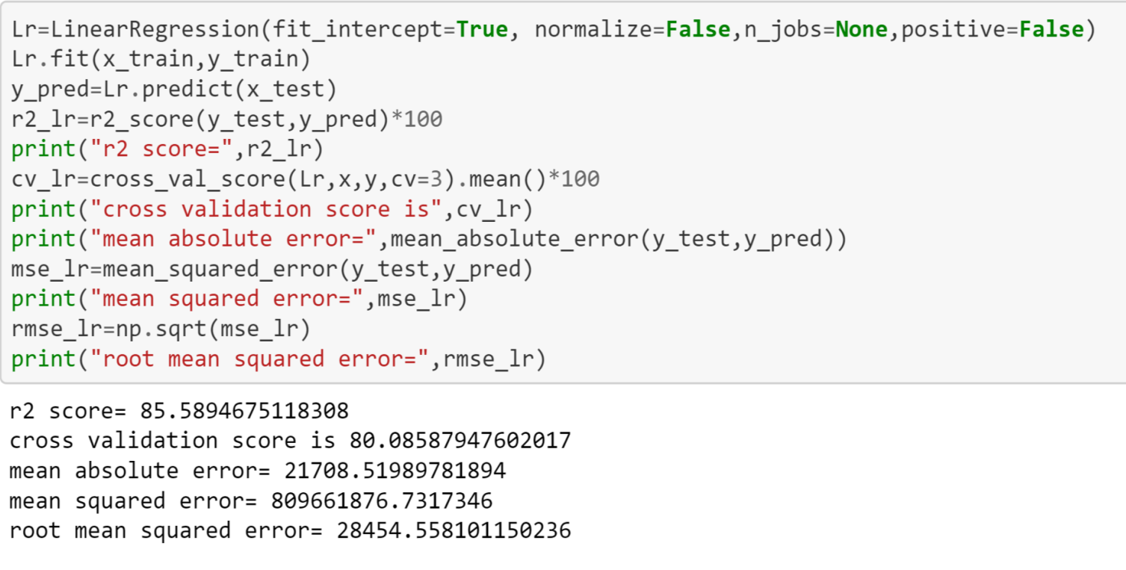
Linear regression
Linear Regression is used between the target variable and other independent variables to find a linear relationship between them. It is a regression model, used for predicting continuous values.

Slide 30
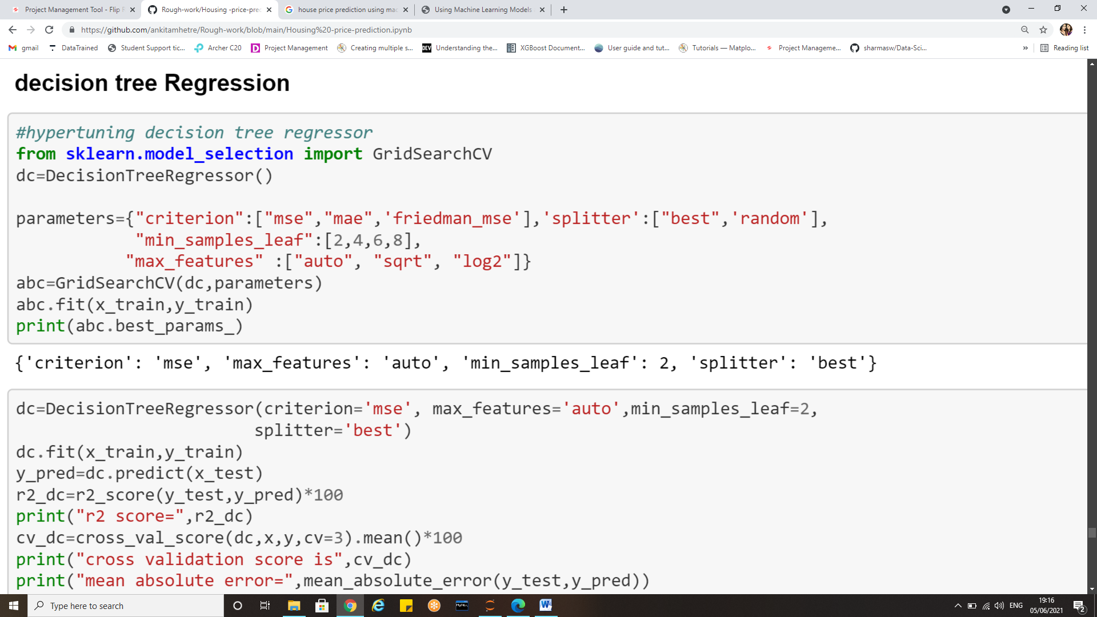
Hyper tuning Decision Tree Regression
The decision tree is a sort of algorithm that requires a label for functioning, and hence they come under supervised learning. The main aim to use the Decision Tree algorithm involves creating a training model used for predicting the target variable’s class or value by studying easy decision order.

Slide 31
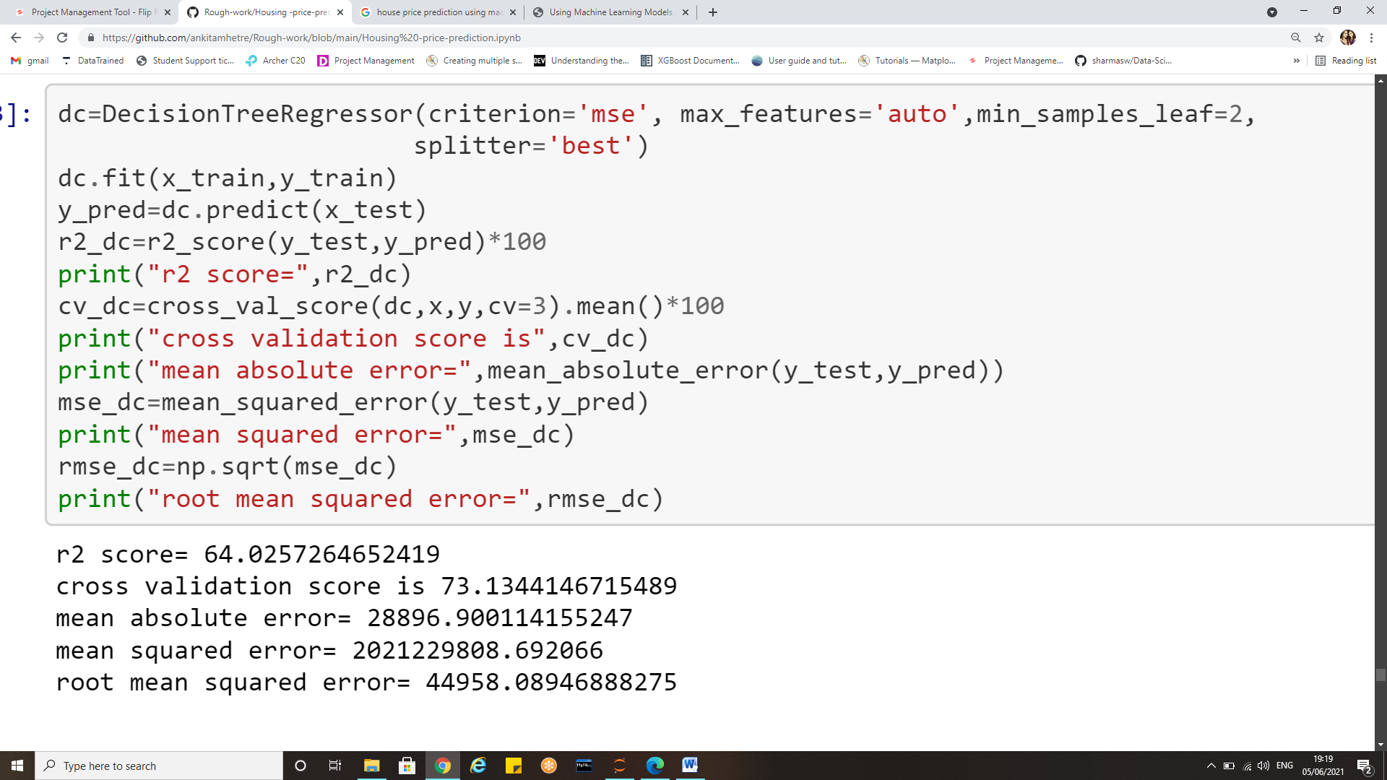
Decision Tree regression

Slide 32
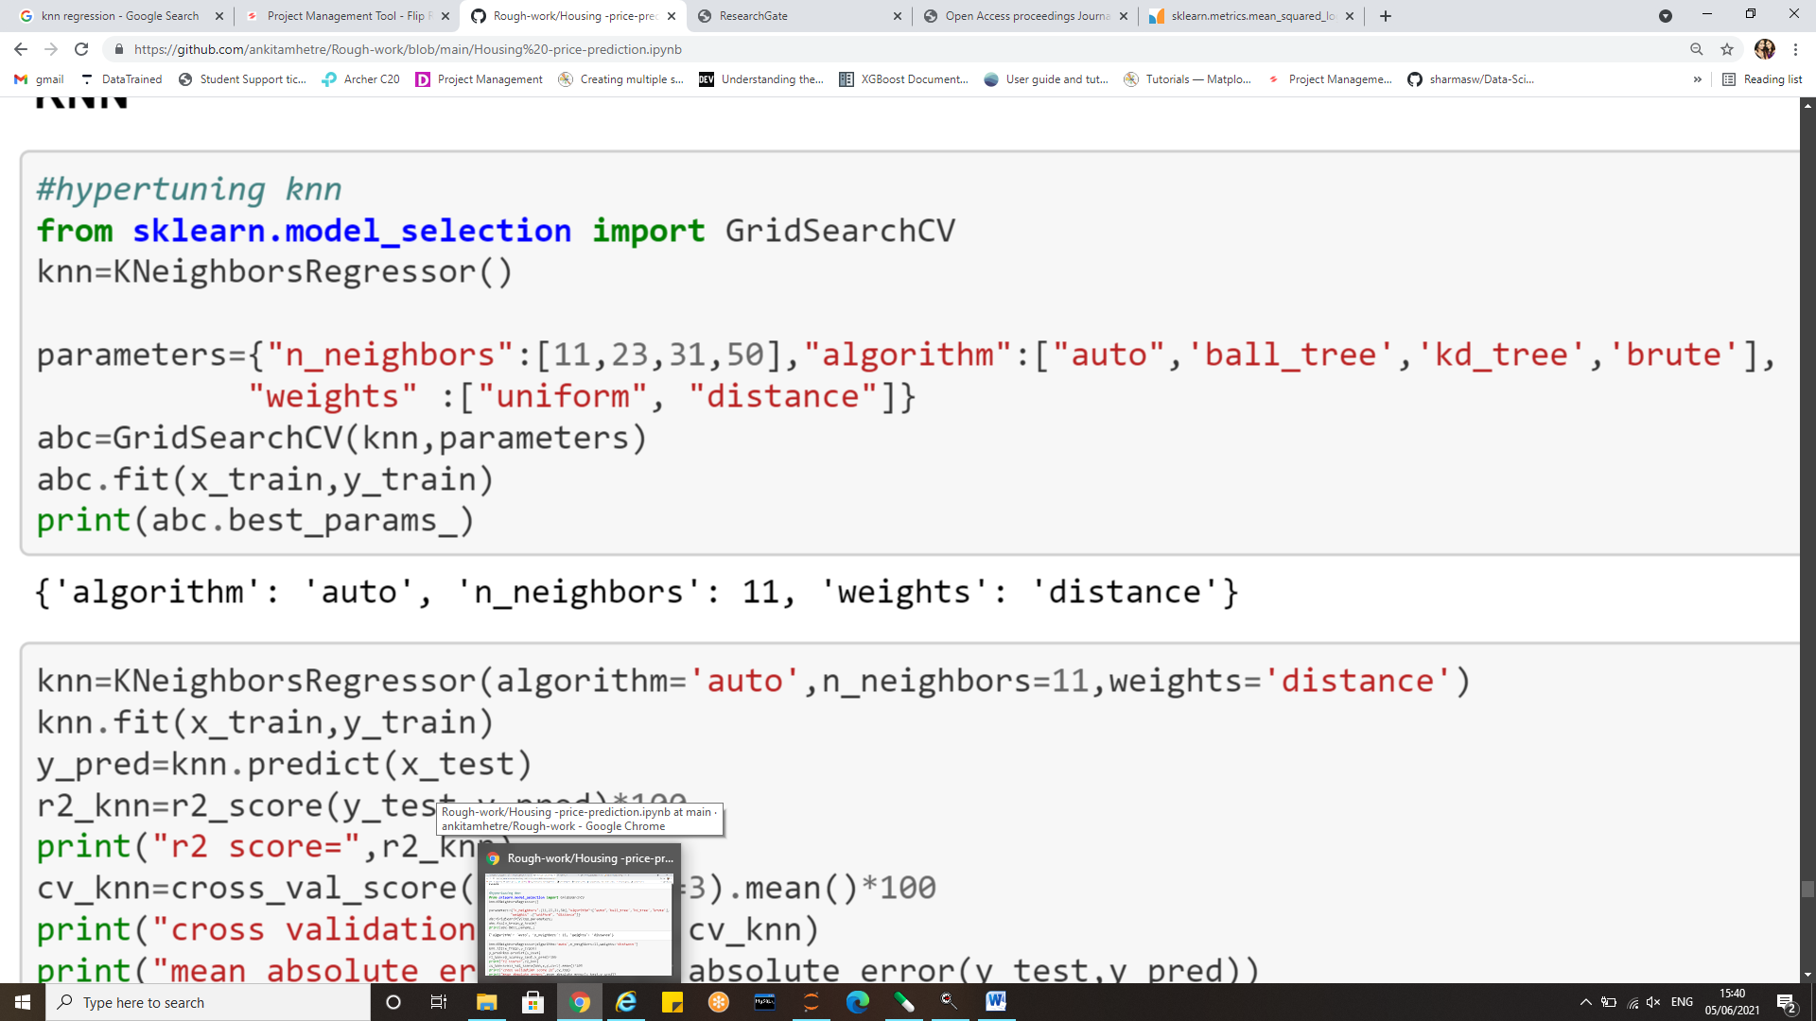
Hyper tuning KNN Regressor
KNN algorithm can be used for both classification and regression problems. The KNN algorithm uses ‘feature similarity’ to predict the values of any new data points. This means that the new point is assigned a value based on how closely it resembles the points in the training set.

Slide 33
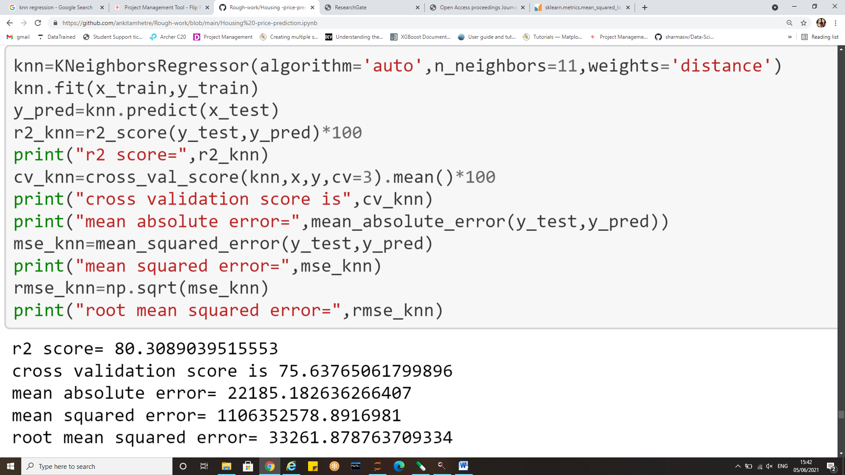
KNN regressor

Slide 34
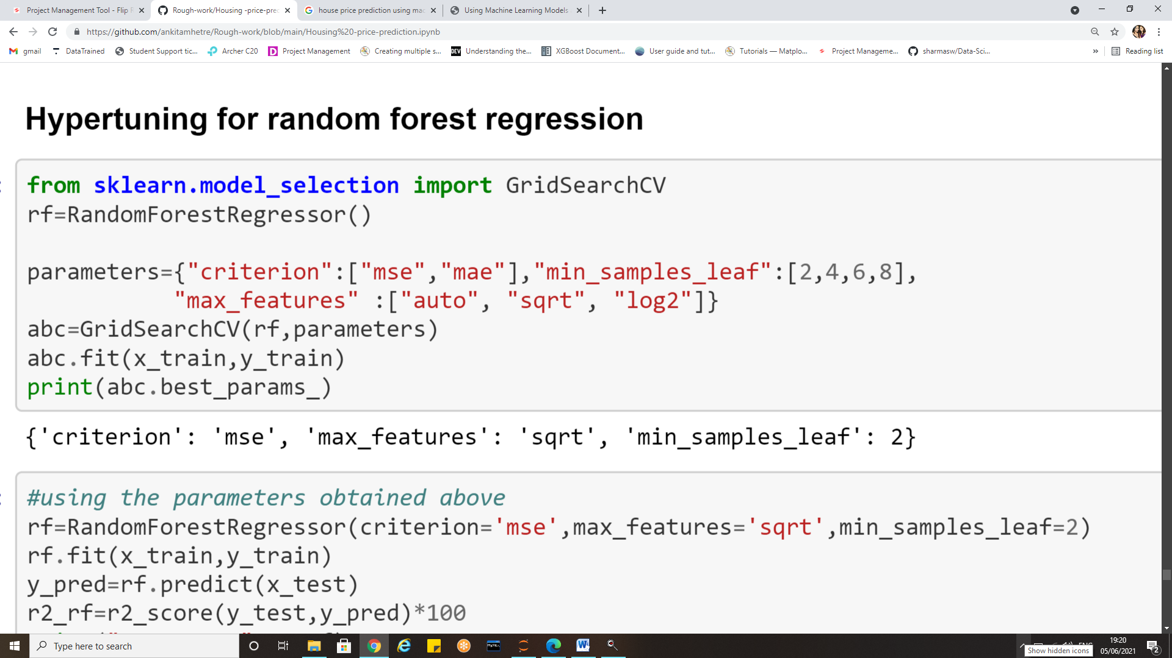
Hyper tuning Random Forest regressor
Random Forest is a supervised learning algorithm. The decision tree is contemplated as a base of the Random Forest algorithm. First of all, it divides the dataset into multiple sets, each set produces a decision tree based on different evaluation metrics used. Later the mean of all the predictions is considered as the final prediction.

Slide 35
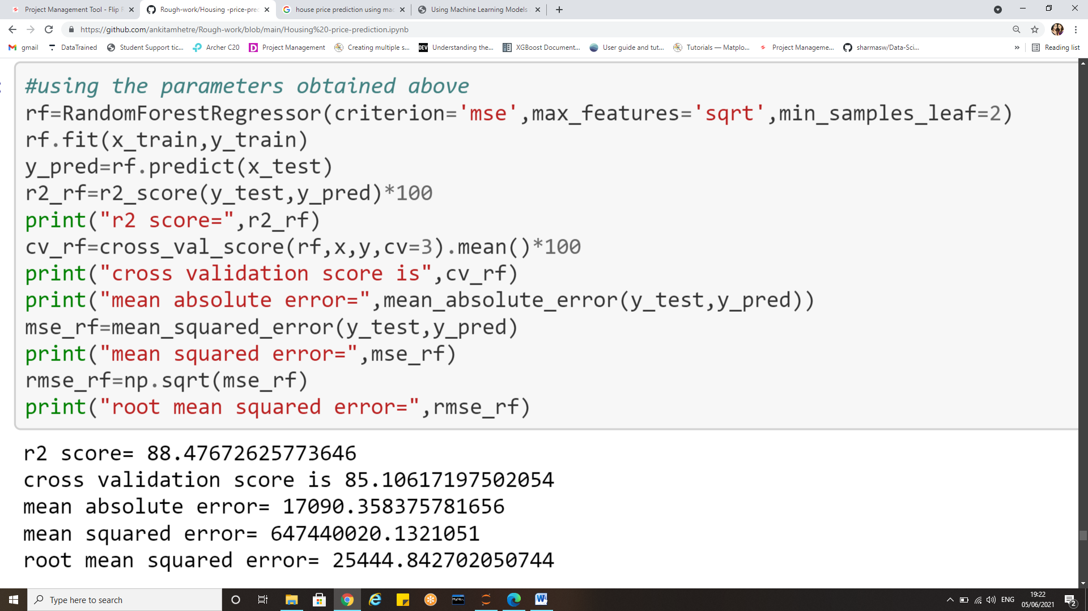
Random Forest Regression

Slide 36
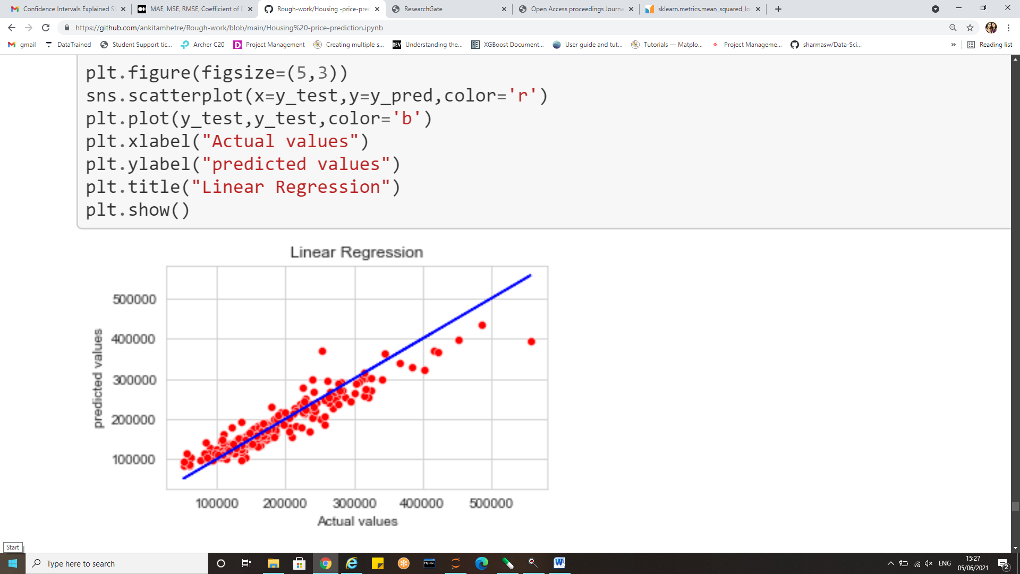
Best fit line for Random Forest

Slide 37
Evaluation metrics
The objective of Regression is to find a line that minimizes the prediction error of all the data points. The essential step in any machine learning model is to evaluate the accuracy of the model.
To evaluate the performance of the model in regression analysis the following are used:
The Mean Squared Error,
Mean absolute error,
Root Mean Squared Error
R-Squared or Coefficient of determination

Slide 38
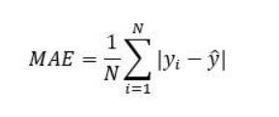
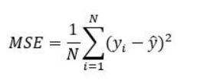
The Mean Absolute Error and mean squared error
The Mean absolute error represents the average of the absolute difference between the actual and predicted values in the dataset. It measures the average of the residuals in the dataset.
Mean Squared Error represents the average of the squared difference between the original and predicted values in the data set. It measures the variance of the residuals.

Slide 39
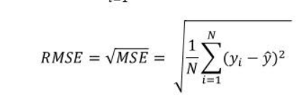
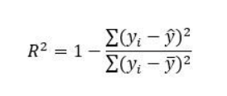
Root mean squared error (RMSE) and R2 Score
Root Mean Squared Error is the square root of Mean Squared error. It measures the standard deviation of residuals.
The coefficient of determination or R-squared represents the proportion of the variance in the dependent variable which is explained by the linear regression model. It is a scale-free score i.e. irrespective of the values being small or large, the value of R square will be less than one.

Slide 40
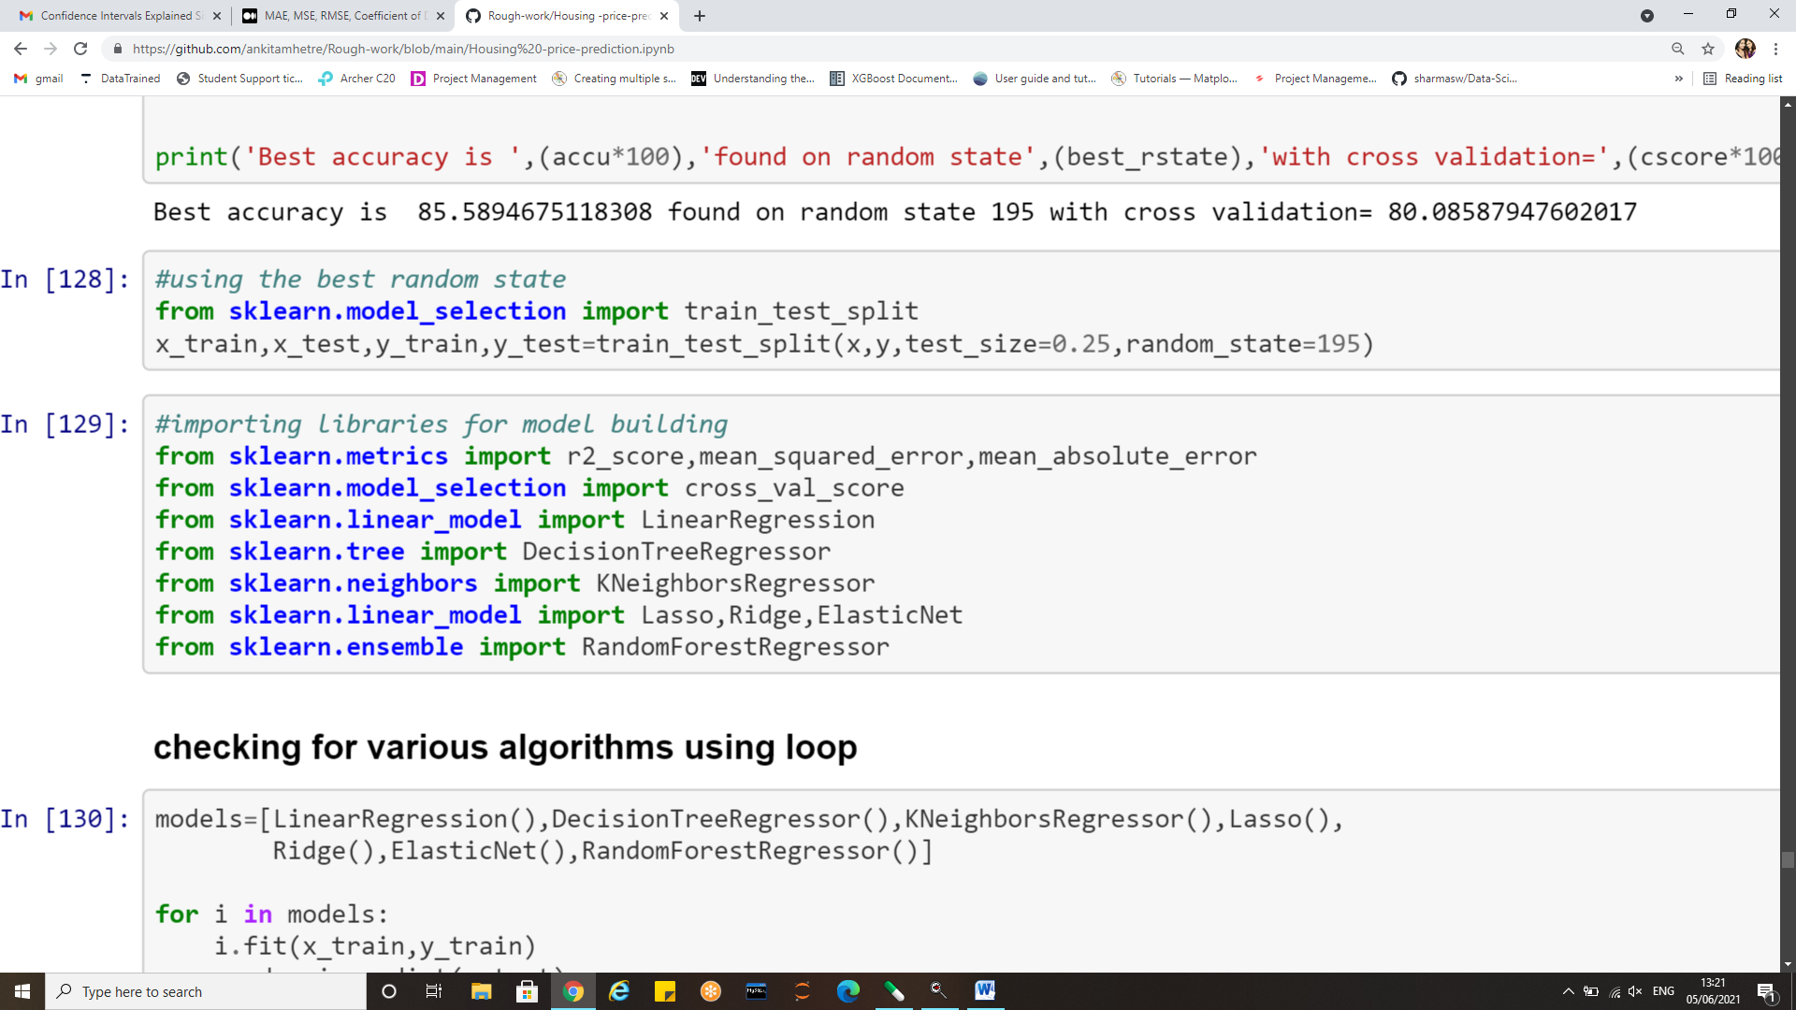
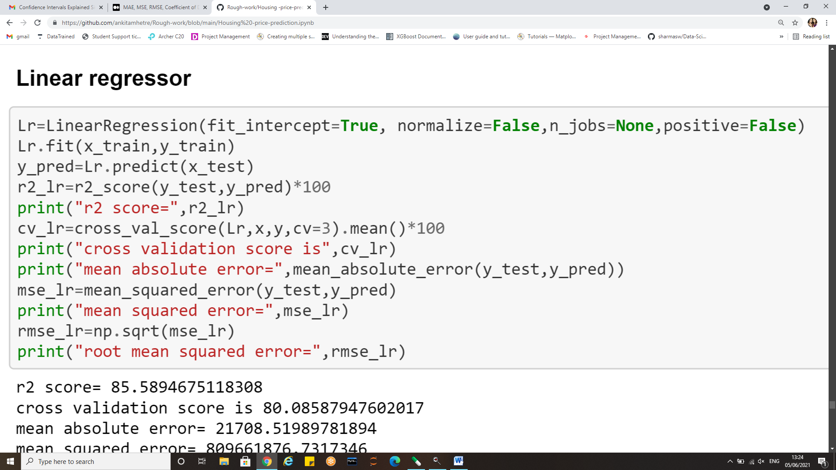
Evaluation metrics from Sklearn

Slide 41
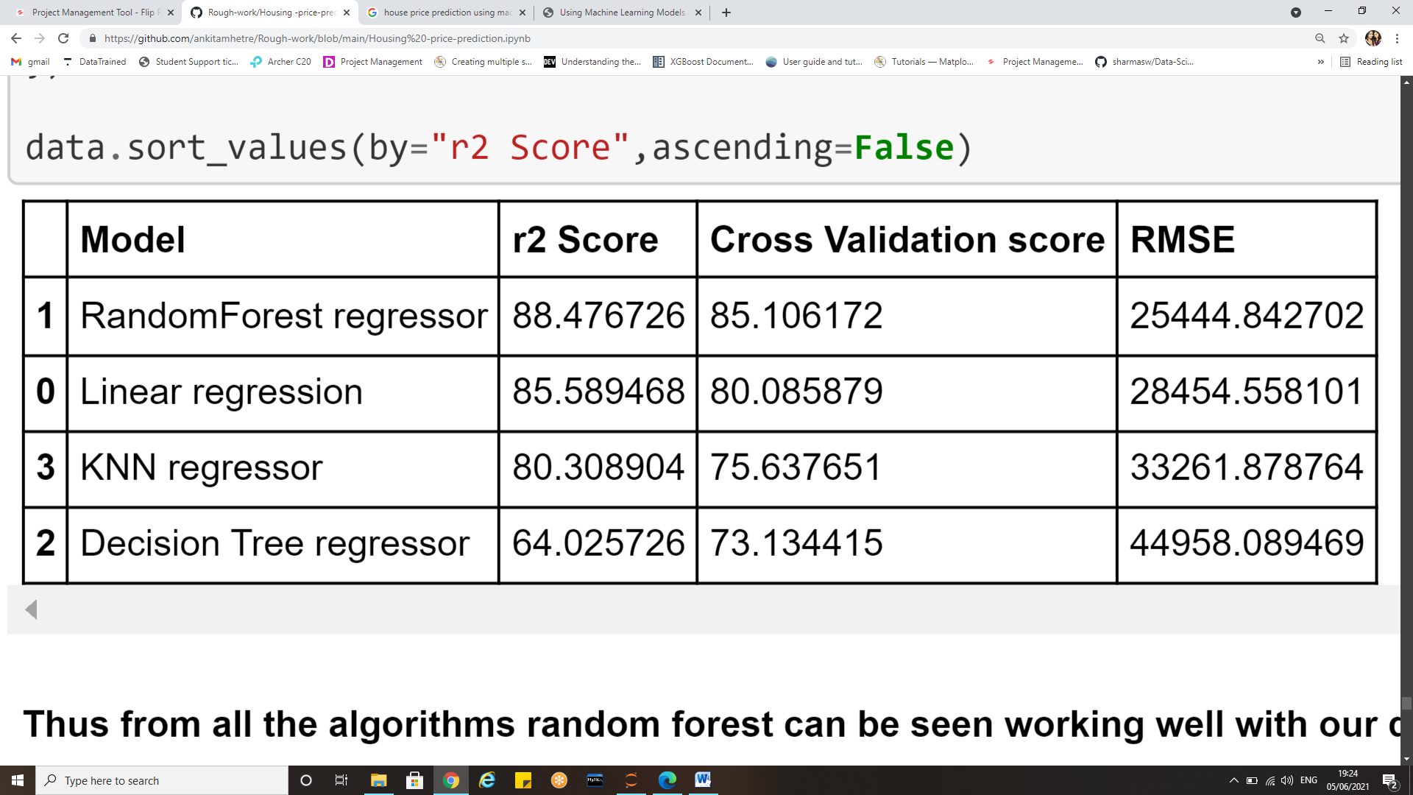
Evaluation metrics of all algorithms used

Slide 42
Conclusion
Mean Squared Error computes the difference between the mean squared of the predicted values and the actual values; Root Mean Square Error computes the square root of the Mean Squared Error.
RMSE is applied to all the four algorithms. R squared or the coefficient of determination is the measure of the closeness of predicted data with the actual data.
With all the comparison metrics, it is observed that Random Forest Regression shows the least Root Mean Square Error with a value of 25552.9797. Therefore, there are fewer errors in this metric as compared to others. Along with this, the R-Squared score is 0.883786, which is 88.37% for Random forest Regression.
Mean Squared Error is also lowest for the Random Forest Regression algorithm with the value of 652952128.330.
The other evaluation metric used, Mean absolute Error also gives the least value with Random Forest.
Apart from Random Forest Regression, Linear Regression also showed satisfactory results with R-Squared score for the same as 0.8558, or 85.58%. The predictions, however, were not very good.

Slide 43
Conclusion
Real estate prices vary due to a wide variety of attributes. The machine learning-based model is a substantial and feasible way to forecast real estate prices, and can provide relatively competitive and satisfactory results.
We have cut down the features from 80 to 56 with the help of inferences from visualizations and EDA performed which reduces the redundancy and has helped built a better model. There is a scope to reduce the number of features too but we have limited it to 55 so that the prediction prices are dependent on more than just few factors which shall be helpful in future.
Features that greatly contribute to house price predictions were locality (neighbourhood) ,above grade living area ,parking capacity of the properties, Basement area and area above grade, facilities like electricity, water, gas septic tanks, fire place, number of full and half baths, the year of construction, Overall quality of the house including exterior and material quality.
Few features like MS Zone, Miscellaneous features, land slope, month in which property was sold, and etc. did not make any significant impact on the prediction of sale prices.
Thus Machine learning models, including linear regression, KNN regression, decision tree regression and random forest regression, were used in this investigation to forecast house prices.

Slide 44
References
Fik T J, Ling D C and Mulligan G F 2003 Modeling spatial variation in housing prices: a variable interaction approach. Real Estate Economics, 31(4), 623-46.
Varma A, Sarma A, Doshi S and Nair R 2018 House Price Prediction Using Machine Learning and Neural Networks. In 2018 Second International Conference on Inventive Communication and Computational Technologies (ICICCT) 1936-39. IEEE.
Bhagat N, Mohokar A and Mane S 2016 House price forecasting using data mining. International Journal of Computer Applications, 152(2), 23-26.
Amri S and Tularam G A 2012 Performance of multiple linear regression and nonlinear neural networks and fuzzy logic techniques in modelling house prices. Journal of Mathematics and Statistics, 8(4), 419-434.
Vineeth N, Ayyappa M and Bharathi B 2018 House Price Prediction Using Machine Learning Algorithms. In International Conference on Soft Computing Systems, 425-33.
Alfiyatin A N, Febrita R E, Taufiq H and Mahmudy W F 2017 Modeling house price prediction using regression analysis and particle swarm optimization. International Journal of Advanced Computer Science and Applications, 8.
Afonso B, Melo L, Oliveira W, Sousa S and Berton L 2019 Housing Prices Prediction with a Deep Learning and Random Forest Ensemble. In Anais do XVI Encontro Nacional de Inteligência Artificial e Computacional 389-400. SBC.
McKinsey & Company 2018|Article Getting ahead of the market: How big data is transforming real estate.

Slide 45
Thank-you

